Slide 1

Pattern behind chaos
Genomic Course project 2021

Slide 2
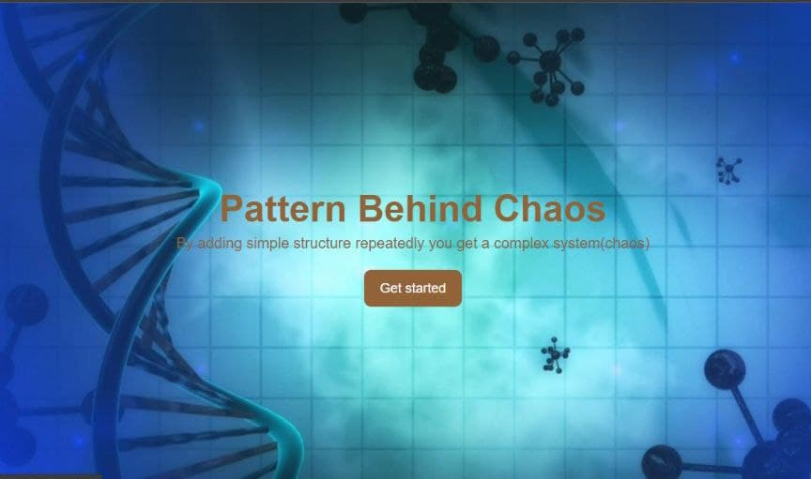
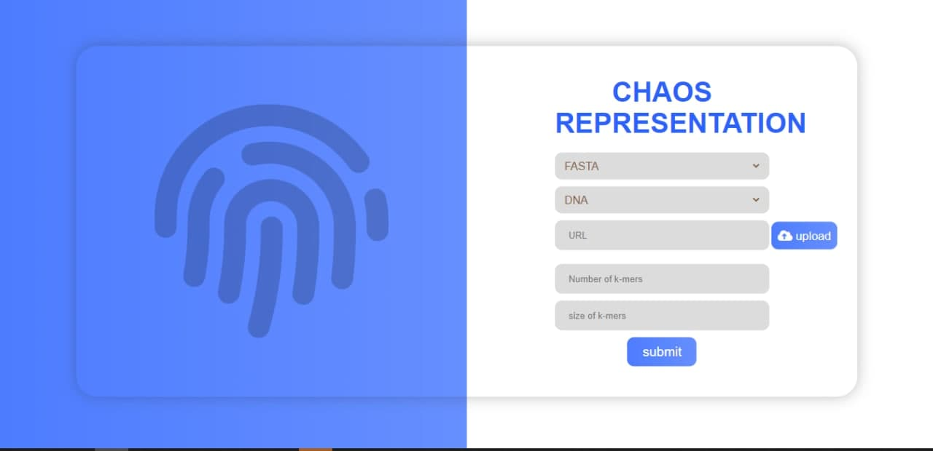
Front End

Slide 3
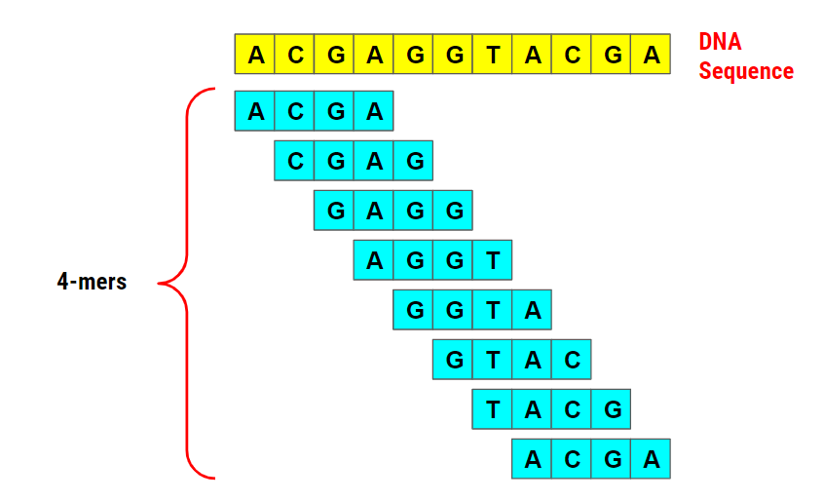
k-mers are substrings of length k in a given string

Slide 4
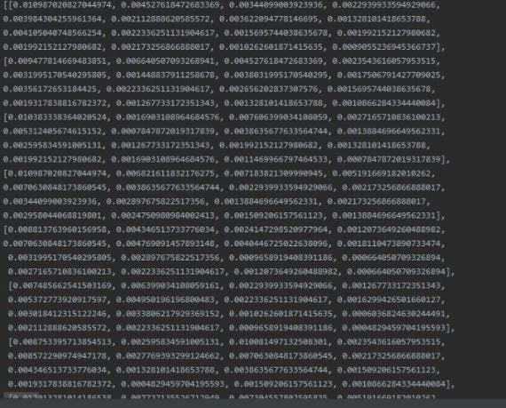
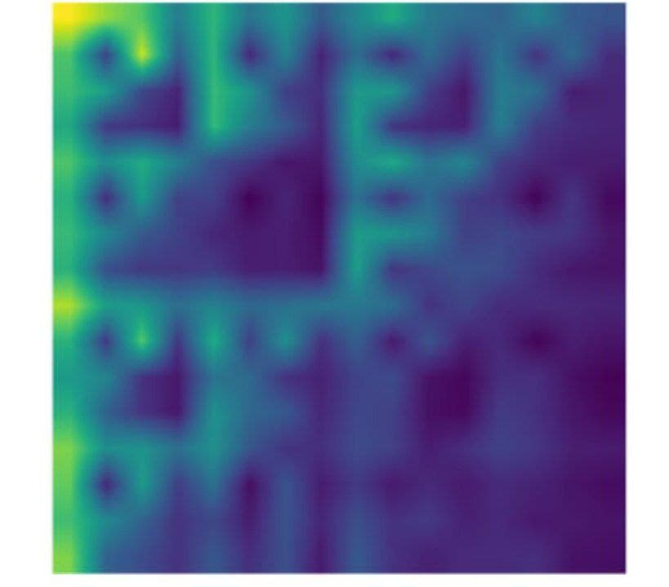
These 2 photos represent the same data
Any data expressed in graph is easier and faster to be understood.

Slide 5
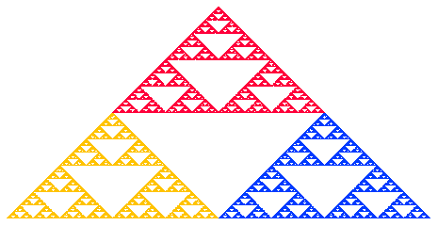
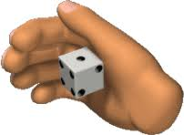
Rolling a die is governed by probabilities but yet it has a pattern , although the process may seem random
1,3 >> Red
2,4 >> Blue
5,6 >> Yellow

Slide 6
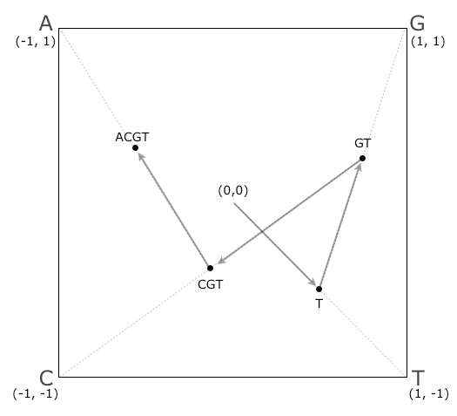
Same Idea applied for DNA bases
Rather than a triangle , pattern is represented for a square
Instead of numbers being hold in the rectangle corners,
bases are being hold in the square corners
The project idea is based on CGR:-
You could have a rough idea in here

Slide 7


IS It Possibly for protein ?!
Polygon with 20 corner !!!?
Protein back to DNA?

Slide 8

Thank you !
Let’s Run some code

Slide 9

Made under the observation of
DR. Sara El-Metwally
Team members are:-
Asmaa Ayman
Samia El-Refaaie
Kirolos Magdy
Mohamed Nasef
Sara Hamad
Grade: Third Year (Medical Informatics)

